Slide 1
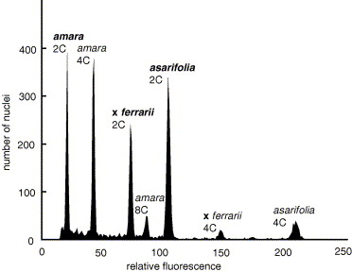
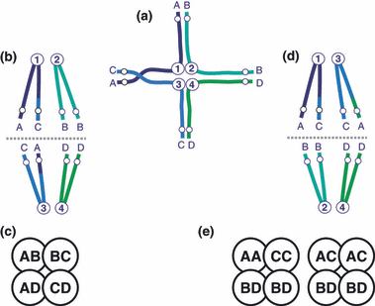
Division of Ecology & Evolutionary Biology
Segregation in tetraploids
Polyploid population genetics workshop, Prague January 2017
Marc Stift

Slide 2
Diploid meiosis
Marc Stift
Gamete formation in a diploid
Meiosis
B
A
B
n=3
n=3
A
2n=6

Slide 3
Diploid meiosis
Marc Stift
Gamete formation in a diploid
Meiosis
B
A
B
n=3
n=3
A
2n=6
A and B symbolize allelic states of a molecular co-dominant marker (for example a microsatellite)
AGCTAGTCGATCGATTATTCATATATATATATATATATCCAGACGTACTGGCATAACCG
=
AGCTAGTCGATCGATTATTC (AT)_{n} CCAGACGTACTGGCATAACCG

Slide 4
Polyploid meiosis
Gamete formation in an autotetraploid
Marc Stift
2n=6
2n=6
2n=6
B
A
B
A
C
A
D
Meiosis
A
D
C
C
4n=12
C
D
B
D
B
2n=6
2n=6
2n=6
Gamete formation in an allotetraploid
2n=6
2n=6
2n=6
B
A
B
A
C
A
D
Meiosis
A
D
C
C
4n=12
C
D
B
D
B
2n=6
2n=6
2n=6

Slide 5
Polyploid meiosis
Gamete formation in an autotetraploid
Marc Stift
2n=6
2n=6
2n=6
B
A
B
A
C
A
D
Meiosis
A
D
C
C
4n=12
C
D
B
D
B
2n=6
2n=6
2n=6
Gamete formation in an allotetraploid
2n=6
2n=6
2n=6
B
A
B
A
C
A
D
Meiosis
A
D
C
C
4n=12
C
D
B
D
B
2n=6
2n=6
2n=6

Slide 6
Inheritance in tetraploids
Intermediate inheritance in tetraploid hybrids
Marc Stift
Allotetraploid
(ABCD)
preferential pairing of homologous chromosomes
Disomic inheritance
Autotetraploid
(ABCD)
no preferential pairing
Tetrasomic inheritance
p(AB) = 0
p(AC) = 1/4
p(AD) = 1/4
p(CD) = 0
p(BD) = 1/4
p(BC) = 1/4
p(AB) = 1/6
p(AC) = 1/6
p(AD) = 1/6
p(CD) = 1/6
p(BD) = 1/6
p(BC) = 1/6
Disomic and tetrasomic inheritance are extremes of a range (depending on the degree of preferential pairing/homology)

Slide 7
Inheritance in tetraploids
Intermediate inheritance in tetraploid hybrids
Marc Stift
Tetraploid
(ABCD)
obs(AB) = 9
obs(AC) = 19
obs(AD) = 20
obs(CD) = 10
obs(BD) = 19
obs(BC) = 19
96

Slide 8
Inheritance in tetraploids
Intermediate inheritance in tetraploid hybrids
Marc Stift
Simplified approach
Compare observed and expected frequencies in χ² type framework
OBSERVED
EXPECTED
Tetraploid
(ABCD)
Disomic inheritance
obs(AB) = 9
obs(AC) = 19
obs(AD) = 20
obs(CD) = 10
obs(BD) = 19
obs(BC) = 19
96
p(AB) = 0
p(AC) = 24 (1/4)
p(AD) = 24 (1/4)
p(CD) = 0
p(BD) = 24 (1/4)
p(BC) = 24 (1/4)
G = ∞

Slide 9
Inheritance in tetraploids
Intermediate inheritance in tetraploid hybrids
Marc Stift
Simplified approach
Compare observed and expected frequencies in χ² type framework
OBSERVED
EXPECTED
Tetraploid
(ABCD)
Disomic inheritance
obs(AB) = 9
obs(AC) = 19
obs(AD) = 20
obs(CD) = 10
obs(BD) = 19
obs(BC) = 19
96
p(AB) = 0
p(AC) = 24 (1/4)
p(AD) = 24 (1/4)
p(CD) = 0
p(BD) = 24 (1/4)
p(BC) = 24 (1/4)
G = ∞

Slide 10
Inheritance in tetraploids
Intermediate inheritance in tetraploid hybrids
Marc Stift
Simplified approach
Compare observed and expected frequencies in χ² type framework
OBSERVED
EXPECTED
EXPECTED
Tetraploid
(ABCD)
Disomic inheritance
Tetrasomic inheritance
obs(AB) = 9
obs(AC) = 19
obs(AD) = 20
obs(CD) = 10
obs(BD) = 19
obs(BC) = 19
96
p(AB) = 0
p(AC) = 24 (1/4)
p(AD) = 24 (1/4)
p(CD) = 0
p(BD) = 24 (1/4)
p(BC) = 24 (1/4)
p(AB) = 16 (1/6)
p(AC) = 16 (1/6)
p(AD) = 16 (1/6)
p(CD) = 16 (1/6)
p(BD) = 16 (1/6)
p(BC) = 16 (1/6)
G = ∞
G = 8.76
At df = 5, ns (p=0.12)

Slide 11
Inheritance in tetraploids
Intermediate inheritance in tetraploid hybrids
Marc Stift
Simplified approach
Compare observed and expected frequencies in χ² type framework
Tetraploid
(ABCD)
Conclusion:
do not reject tetrasomic inheritance
=> Typical autotetraploid inheritance??
What about intermediate inheritance ??
obs(AB) = 9
obs(AC) = 19
obs(AD) = 20
obs(CD) = 10
obs(BD) = 19
obs(BC) = 19
96

Slide 12
Inheritance in Tetraploids
δ1 = degree of preferential pairing A & B
δ2 = degree of preferential pairing A & C
δ3 = degree of preferential pairing A & D
Intermediate inheritance in tetraploid hybrids
Marc Stift
τ = degree of tetrasomy
A nonlinear modelling approach
δ1 + δ2 + δ3 = 1
δ1*δ2*δ3 = 0
0 < τ < 1
Stift et al 2008 Genetics

Slide 13
Inheritance in tetraploids
Intermediate inheritance in tetraploid hybrids
Marc Stift
Nonlinear model
Allotetraploid
model
(ABCD)
τ = 0, δ1 = 1
(disomic inheritance, A-B pairing preference)
p
Stift et al 2008 Genetics

Slide 14
Inheritance in tetraploids
Intermediate inheritance in tetraploid hybrids
Marc Stift
Nonlinear model
Allotetraploid
model
(ABCD)
τ = 0, δ1 = 1
(disomic inheritance, A-B pairing preference)
p
Stift et al 2008 Genetics

Slide 15
Inheritance in tetraploids
Intermediate inheritance in tetraploid hybrids
Marc Stift
Nonlinear model
Allotetraploid
model
(ABCD)
τ = 0, δ1 = 1
(disomic inheritance, A-B pairing preference)
p
Stift et al 2008 Genetics

Slide 16
Inheritance in tetraploids
Intermediate inheritance in tetraploid hybrids
Marc Stift
Nonlinear model
Allotetraploid
model
(ABCD)
τ = 0, δ1 = 1
(disomic inheritance, A-B pairing preference)
exp(AB) = 0
exp(AC) = 1/4
exp(AD) = 1/4
exp(CD) = 0
exp(BD) = 1/4
exp(BC) = 1/4
Stift et al 2008 Genetics

Slide 17
Inheritance in tetraploids
Intermediate inheritance in tetraploid hybrids
Marc Stift
Nonlinear model
τ = 0, δ1 = 1
(disomic inheritance, A-B pairing preference)
τ = 1
p
Stift et al 2008 Genetics

Slide 18
Inheritance in tetraploids
Intermediate inheritance in tetraploid hybrids
Marc Stift
Nonlinear model
Autotetraploid
model
(ABCD)
τ = 0, δ1 = 1
(disomic inheritance, A-B pairing preference)
τ = 1
(tetrasomic inheritance)
p(AB) = 1/6
p(AC) = 1/6
p(AD) = 1/6
p(CD) = 1/6
p(BD) = 1/6
p(BC) = 1/6
p
Stift et al 2008 Genetics

Slide 19
Inheritance in tetraploids
Intermediate inheritance in tetraploid hybrids
Marc Stift
Nonlinear model
Autotetraploid
model
(ABCD)
τ = 0, δ1 = 1
(disomic inheritance, A-B pairing preference)
τ = 1
(tetrasomic inheritance)
Tetraploid
(ABCD)
p
obs(AB) = 9
obs(AC) = 19
obs(AD) = 20
obs(CD) = 10
obs(BD) = 19
obs(BC) = 19
96
exp(AB) = 16 (1/6)
exp(AC) = 16 (1/6)
exp(AD) = 16 (1/6)
exp(CD) = 16 (1/6)
exp(BD) = 16 (1/6)
exp(BC) = 16 (1/6)
G = 8.76 At df=5, NS
Stift et al 2008 Genetics

Slide 20
Inheritance in tetraploids
Intermediate inheritance in tetraploid hybrids
Marc Stift
Allotetraploid
model
(ABCD)
Intermediate model
(ABCD)
Autotetraploid
model
(ABCD)
τ = 0, δ1 = 1
(disomic inheritance, A-B pairing preference)
τ = 1
(tetrasomic inheritance)
Tetraploid
(ABCD)
p
p
obs(AB) = 9
obs(AC) = 19
obs(AD) = 20
obs(CD) = 10
obs(BD) = 19
obs(BC) = 19
96
exp(AB) = 0
exp(AC) = 24 (1/4)
exp(AD) = 24 (1/4)
exp(CD) = 0
exp(BD) = 24 (1/4)
exp(BC) = 24 (1/4)
exp(AB) = 16 (1/6)
exp(AC) = 16 (1/6)
exp(AD) = 16 (1/6)
exp(CD) = 16 (1/6)
exp(BD) = 16 (1/6)
exp(BC) = 16 (1/6)
G = ∞
G = 8.76 (NS at df=5)
Stift et al 2008 Genetics

Slide 21
Inheritance in tetraploids
Intermediate inheritance in tetraploid hybrids
Marc Stift
Allotetraploid
model
(ABCD)
Intermediate model
(ABCD)
Autotetraploid
model
(ABCD)
τ = 0, δ1 = 1
(disomic inheritance, A-B pairing preference)
τ = 0.9, δ1 = 1
(intermediate inheritance, some A-B pairing preference)
τ = 1
(tetrasomic inheritance)
Tetraploid
(ABCD)
p
p
obs(AB) = 9
obs(AC) = 19
obs(AD) = 20
obs(CD) = 10
obs(BD) = 19
obs(BC) = 19
96
exp(AB) = 0
exp(AC) = 24 (1/4)
exp(AD) = 24 (1/4)
exp(CD) = 0
exp(BD) = 24 (1/4)
exp(BC) = 24 (1/4)
exp(AB) = 16 (1/6)
exp(AC) = 16 (1/6)
exp(AD) = 16 (1/6)
exp(CD) = 16 (1/6)
exp(BD) = 16 (1/6)
exp(BC) = 16 (1/6)
G = ∞
G = 8.76
Stift et al 2008 Genetics

Slide 22
Inheritance in tetraploids
Intermediate inheritance in tetraploid hybrids
Marc Stift
Allotetraploid
model
(ABCD)
Intermediate model
(ABCD)
Autotetraploid
model
(ABCD)
τ = 0, δ1 = 1
(disomic inheritance, A-B pairing preference)
τ = 0.9, δ1 = 1
(intermediate inheritance, some A-B pairing preference)
τ = 1
(tetrasomic inheritance)
Tetraploid
(ABCD)
p
p
obs(AB) = 9
obs(AC) = 19
obs(AD) = 20
obs(CD) = 10
obs(BD) = 19
obs(BC) = 19
96
exp(AB) = 0
exp(AC) = 24 (1/4)
exp(AD) = 24 (1/4)
exp(CD) = 0
exp(BD) = 24 (1/4)
exp(BC) = 24 (1/4)
exp(AB) = 14.4
exp(AC) = 16.8
exp(AD) = 16.8
exp(CD) = 14.4
exp(BD) = 16.8
exp(BC) = 16.8
exp(AB) = 16 (1/6)
exp(AC) = 16 (1/6)
exp(AD) = 16 (1/6)
exp(CD) = 16 (1/6)
exp(BD) = 16 (1/6)
exp(BC) = 16 (1/6)
G = ∞
G = 5.25
G = 8.76
Stift et al 2008 Genetics

Slide 23
Inheritance in tetraploids
Intermediate inheritance in tetraploid hybrids
Marc Stift
Allotetraploid
model
(ABCD)
Intermediate model
(ABCD)
Autotetraploid
model
(ABCD)
τ = 0, δ1 = 1
(disomic inheritance, A-B pairing preference)
τ = 0.8, δ1 = 1
(intermediate inheritance, some A-B pairing preference)
τ = 1
(tetrasomic inheritance)
Tetraploid
(ABCD)
p
p
obs(AB) = 9
obs(AC) = 19
obs(AD) = 20
obs(CD) = 10
obs(BD) = 19
obs(BC) = 19
96
exp(AB) = 0
exp(AC) = 24 (1/4)
exp(AD) = 24 (1/4)
exp(CD) = 0
exp(BD) = 24 (1/4)
exp(BC) = 24 (1/4)
exp(AB) = 12.8
exp(AC) = 17.6
exp(AD) = 17.6
exp(CD) = 12.8
exp(BD) = 17.6
exp(BC) = 17.6
exp(AB) = 16 (1/6)
exp(AC) = 16 (1/6)
exp(AD) = 16 (1/6)
exp(CD) = 16 (1/6)
exp(BD) = 16 (1/6)
exp(BC) = 16 (1/6)
G = ∞
G = 2.56
G = 8.76
Stift et al 2008 Genetics

Slide 24
Inheritance in tetraploids
Intermediate inheritance in tetraploid hybrids
Marc Stift
Allotetraploid
model
(ABCD)
Intermediate model
(ABCD)
Autotetraploid
model
(ABCD)
τ = 0, δ1 = 1
(disomic inheritance, A-B pairing preference)
τ = 0.7, δ1 = 1
(intermediate inheritance, some A-B pairing preference)
τ = 1
(tetrasomic inheritance)
Tetraploid
(ABCD)
p
p
obs(AB) = 9
obs(AC) = 19
obs(AD) = 20
obs(CD) = 10
obs(BD) = 19
obs(BC) = 19
96
exp(AB) = 0
exp(AC) = 24 (1/4)
exp(AD) = 24 (1/4)
exp(CD) = 0
exp(BD) = 24 (1/4)
exp(BC) = 24 (1/4)
exp(AB) = 11.2
exp(AC) = 18.4
exp(AD) = 18.4
exp(CD) = 11.2
exp(BD) = 18.4
exp(BC) = 18.4
exp(AB) = 16 (1/6)
exp(AC) = 16 (1/6)
exp(AD) = 16 (1/6)
exp(CD) = 16 (1/6)
exp(BD) = 16 (1/6)
exp(BC) = 16 (1/6)
G = ∞
G = 0.79
G = 8.76
Stift et al 2008 Genetics

Slide 25
Inheritance in tetraploids
Intermediate inheritance in tetraploid hybrids
Marc Stift
Allotetraploid
model
(ABCD)
Intermediate model
(ABCD)
Autotetraploid
model
(ABCD)
τ = 0, δ1 = 1
(disomic inheritance, A-B pairing preference)
τ = 0.6, δ1 = 1
(intermediate inheritance, some A-B pairing preference)
τ = 1
(tetrasomic inheritance)
Tetraploid
(ABCD)
p
p
obs(AB) = 9
obs(AC) = 19
obs(AD) = 20
obs(CD) = 10
obs(BD) = 19
obs(BC) = 19
96
exp(AB) = 0
exp(AC) = 24 (1/4)
exp(AD) = 24 (1/4)
exp(CD) = 0
exp(BD) = 24 (1/4)
exp(BC) = 24 (1/4)
exp(AB) = 9.6
exp(AC) = 19.2
exp(AD) = 19.2
exp(CD) = 9.6
exp(BD) = 19.2
exp(BC) = 19.2
exp(AB) = 16 (1/6)
exp(AC) = 16 (1/6)
exp(AD) = 16 (1/6)
exp(CD) = 16 (1/6)
exp(BD) = 16 (1/6)
exp(BC) = 16 (1/6)
G = ∞
G = 0.09
G = 8.76
Likelihood Ratio Test: 8.76 vs. 0.09 at df=1, P=0.0032
Stift et al 2008 Genetics

Slide 26
Inheritance in tetraploids
Intermediate inheritance in tetraploid hybrids
Marc Stift
Plot of G (~ inverse likelihood)
Maximum likelihood
obs(AB) = 9
obs(AC) = 19
obs(AD) = 20
obs(CD) = 10
obs(BD) = 19
obs(BC) = 19
96
G
δ1=1
τ
Stift et al 2008 Genetics

Slide 27
Inheritance in tetraploids
So, will this method be useful to easily assess inheritance in any tetraploid species??
Practical limitations:
Co-dominant markers must be available (microsatellites)
Strategic crosses must be possible: ideally with plants with completely resolved heterozygous genotypes (for example ABCD x EEEE or ABCD x EFGH)
Money must be available to screen large numbers of progeny in order to deduce gamete genotypes

Slide 28
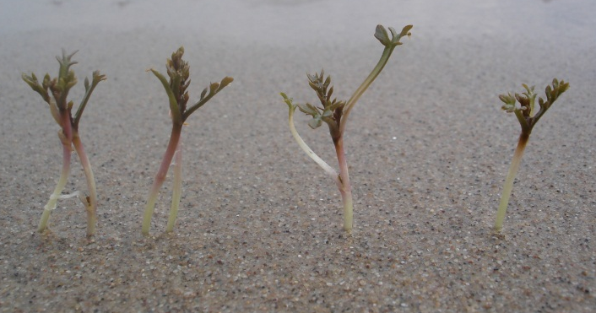
Inheritance in tetraploids
Intermediate inheritance in tetraploid hybrids
Marc Stift
Rorippa amphibia sylvestris
Diploids
Tetraploids (AAAA)
Tetraploids (SSSS)
Hexaploids

Slide 29
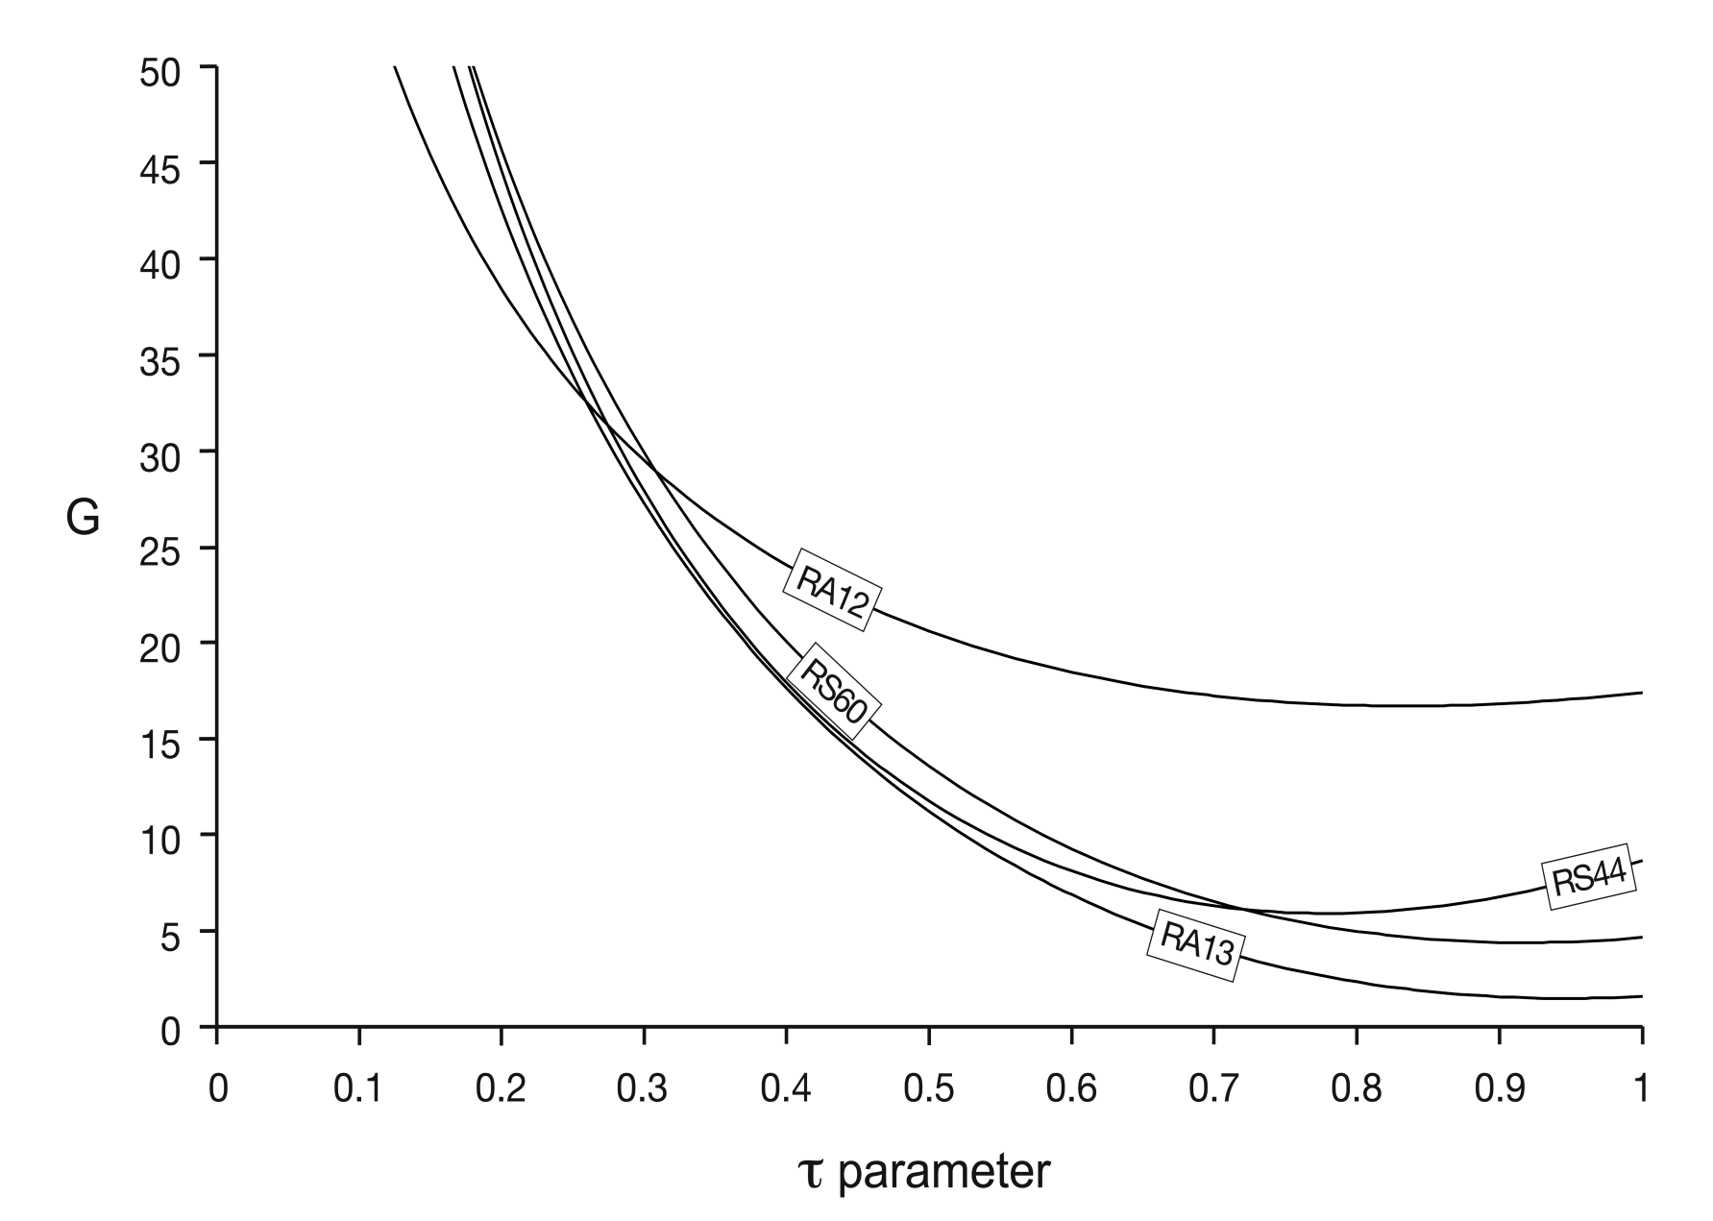
Inheritance in tetraploids
Intermediate inheritance in tetraploid hybrids
Marc Stift
Tetraploid plant R. sylvestris
LRT: τ_{opt} no significantly better fit than τ=1
=>Tetrasomic inheritance
Disomic
Tetrasomic
Stift et al 2008 Genetics

Slide 30
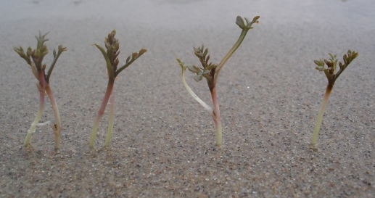
Inheritance in tetraploids
Intermediate inheritance in tetraploid hybrids
Marc Stift
Rorippa F1 hybrids
X
Inheritance intermediate to disomic and tetrasomic?
Parents recognised as separate species
(=> allotetraploid)
Parental genomes homologous enough to allow hybridisation and backcrossing
(=> autotetraploid)
Notes:
Punt 2 weghalen

Slide 31
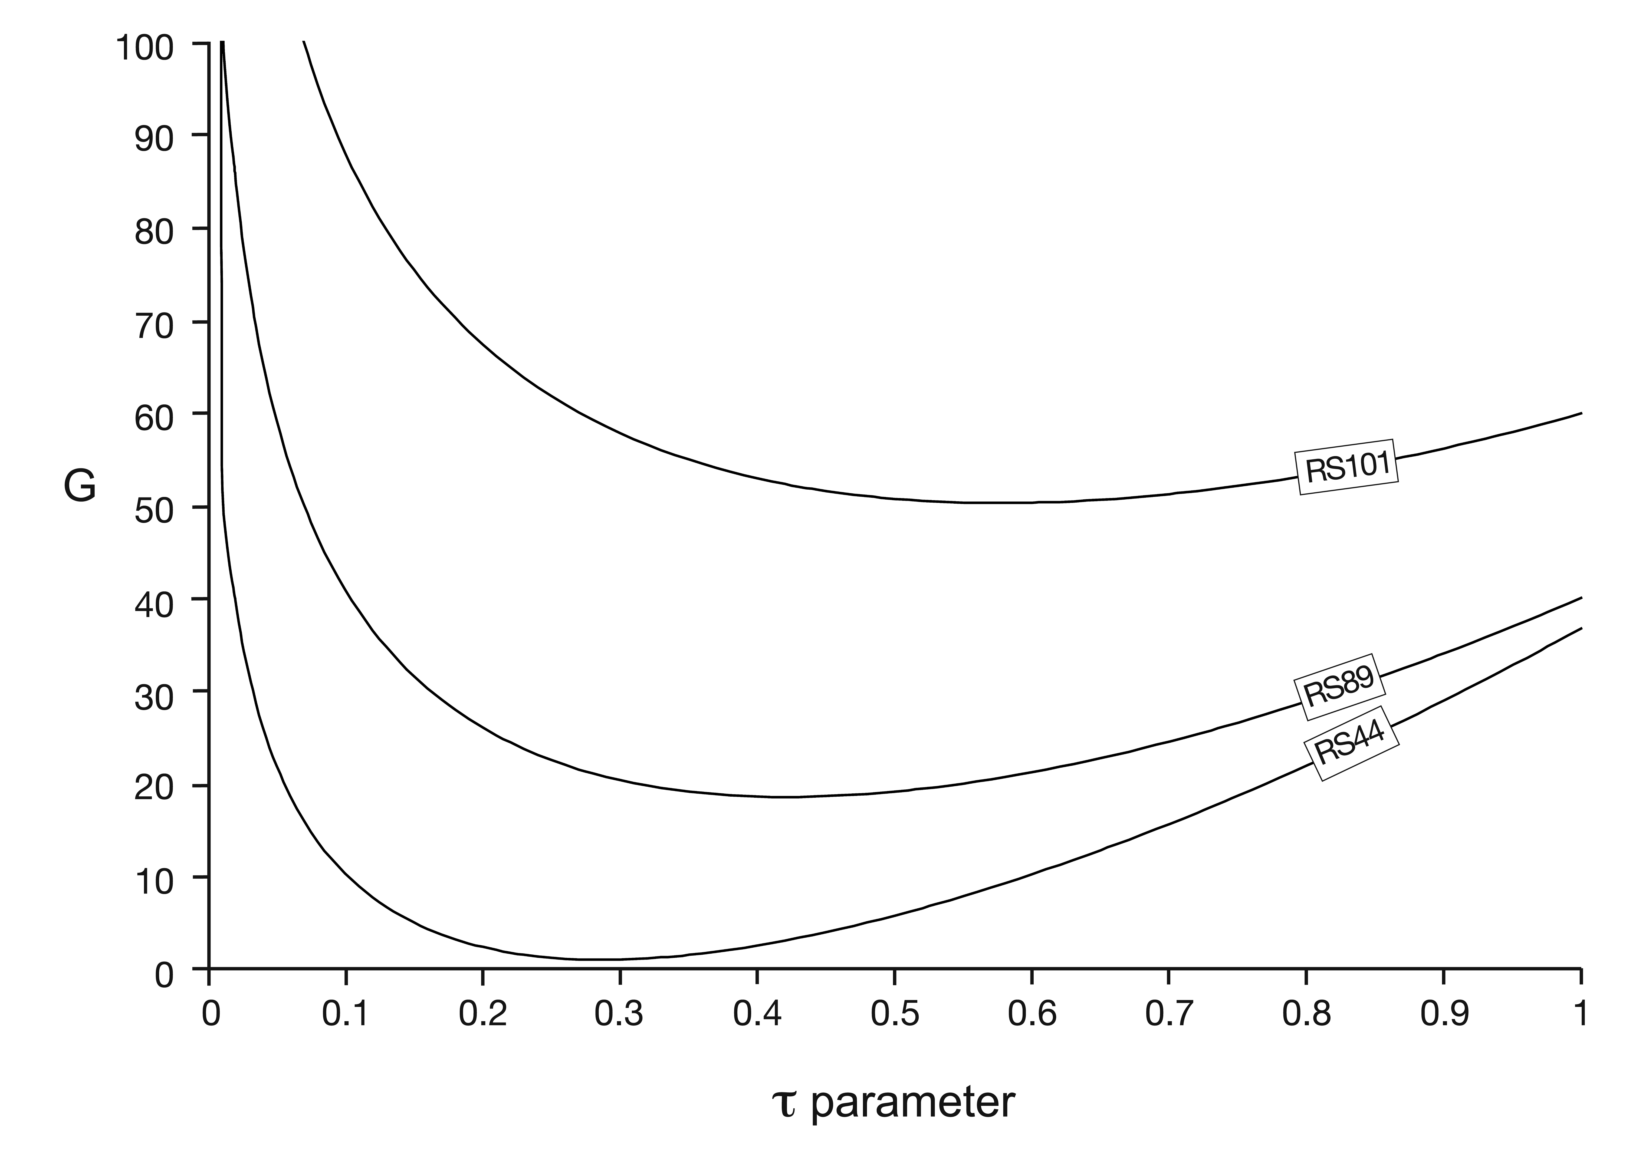
Inheritance in tetraploids
Intermediate inheritance in tetraploid hybrids
Marc Stift
Tetraploid F1 hybrid
LRT: τ_{opt} significantly better fit than τ=1 or τ=0
=> Inheritance intermediate between disomic and tetrasomic
Disomic
Tetrasomic
Stift et al 2008 Genetics

